Slide 1

Store Annual Data Analysis Dashboard

Slide 2
Project Purpose: Store Annual Data Analysis Dashboard
The purpose of this project is to develop an interactive store annual data dashboard that provides real-time insights into sales performance across various metrics and dimensions. The dashboard aims to empower business analysts and decision-makers with actionable data to optimize sales strategies, improve customer engagement, and enhance overall profitability throughout 2022.
Key Objectives:
Track Sales Metrics Monitor key performance indicators such as total sales amount, quantity sold, profit, and average order value.
Understand Payment Preferences Assess customer payment mode preferences, with a focus on the predominant Cash On Delivery method.
Category Sales Insights Gain insights into product category performance, especially the high sales volume of clothing items.
Customer Contribution Analysis Analyze individual customer contributions to sales and develop targeted marketing campaigns.
Monthly Profit Trends Observe monthly profit trends to plan for seasonal variations and promotional activities.
Product Category Profitability Investigate category-specific profitability to make informed decisions on inventory and product development.
This dashboard serves as a strategic tool for the store business, enabling a data-driven approach to enhancing sales performance and customer satisfaction 📈🛍️.

Slide 3
Skills Utilized in Store Data Dashboard Report
Data Analysis
Analysing sales data to extract insights.
Interpreting trends and patterns.
Data Visualization
Creating intuitive charts and graphs.
Customizing visual elements for clarity.
UX Design
Crafting user-friendly interfaces.
Ensuring responsive design.
Presentation Skills
Organizing information effectively.
Enhancing visual appeal.
Tools Used
[ MS Excel ]

Slide 4
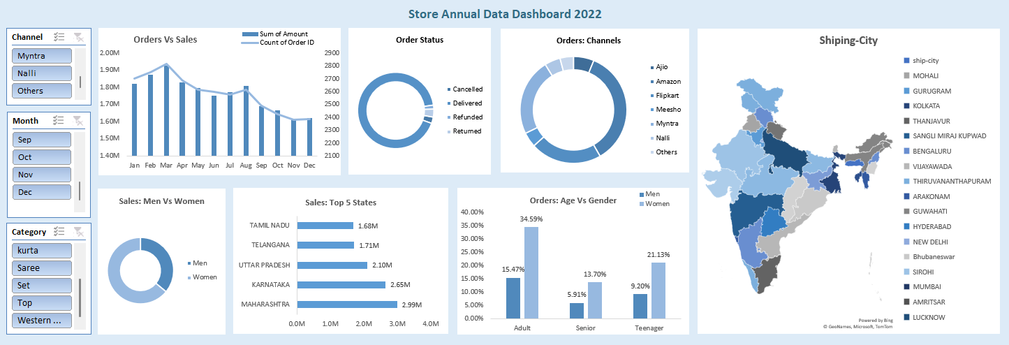

Slide 5
Store Data Dashboard Performance Overview
The Store Annual Data Analysis Dashboard is a meticulously crafted tool designed to dissect and understand the intricacies of the store’s sales data for the year 2022. The dashboard’s primary objective is to distill vast amounts of sales information into actionable insights that can drive strategic business decisions.
Comprehensive Overview of the Dashboard
The dashboard presents a multi-faceted view of the store’s performance, encapsulating various key performance indicators (KPIs) that are crucial for assessing the health and progress of the business. It serves as a visual narrative of the store’s journey over the year, highlighting successes and areas for improvement.
Sales Channels: A significant insight from the dashboard is the distribution of orders across various sales channels. Myntra emerges as a dominant platform, suggesting a strong partnership or customer preference that the store can further capitalize on.
Monthly Sales Trends: The dashboard reveals that sales surged during the festive months of October and November. This trend underscores the importance of seasonal marketing and inventory preparedness to maximize revenue during peak shopping periods.
Order Fulfillment: The order status pie chart reflects a high rate of successful deliveries, a testament to the store’s operational efficiency. The low cancellation and return rates indicate customer satisfaction with the products and services offered.
Customer Demographics: The sales distribution between men and women provides valuable insights into consumer behavior. The higher sales attributed to men could inform targeted marketing campaigns and product development strategies.
Regional Performance: The bar graph showcasing sales across the top five states offers a geographical perspective on the store’s market penetration. Maharashtra’s leading position points to a strong customer base that can be nurtured and expanded.

